Slide 1
Reported Vote, 1999 election in Chile in a UNDP survey
Valid vote for a candidate: 1270
Blank/null vote: 103
Abstain: 23
Undecided: 269
Not registered: 254

Slide 2
How do we model this outcome?
Why cannot I do OLS/Ordered logit?
Model “valid vote” as a binary logit?
  Assumes all other options have the same cause
  Lose the variety in the data (comprising ~65% of the sample)

Slide 3
Modeling Categorical Outcomes
Stochastic Utility Theory/Discrete Choice
j outcomes (Y₁, Y₂, … Y_{j})
Each one has a utility associated with it generated by X_{i}β_{j}
  Note the subscript on the betas
  Essentially are estimating a series of logits
One with the biggest utility is chosen

Slide 4
Estimate a Series of Equations
Y₁= β_{0.1} + β_{1.1}X₁ + β_{2.1}X₂ + β_{3.1}X₃ + ε₁
Y₂= β_{0.2} + β_{1.2}X₁ + β_{2.2}X₂ + β_{3.2}X₃ + ε₂
…
Y_{j}= β_{0.j} + β_{1.j}X₁ + β_{2.j}X₂ + β_{3.j}X₃ + ε_{j}
Find the unique β for each equation
Multinomial logit for the function

Slide 5
The problem of identification
Can’t have more unknowns than equations
Identifying restrictions make it possible to solve the models
  E.g. in logit and ordered logit we fix the variance and assume symmetry
In Multinomial Logit, we make one set of coefficients equal 0 and assume errors are independent across outcomes
  Set baseline
If cannot make the latter assumption, (try to) do multinomial probit

Slide 6
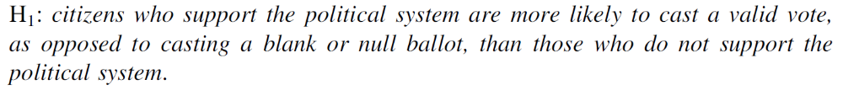
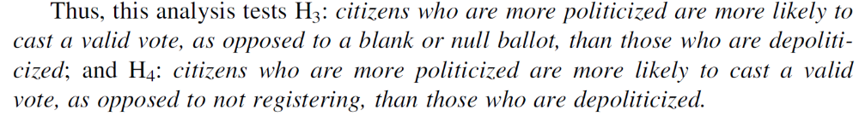
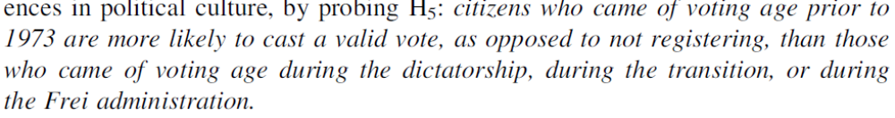
Example Carlin 2006
Hypothesize accordingly

Slide 7
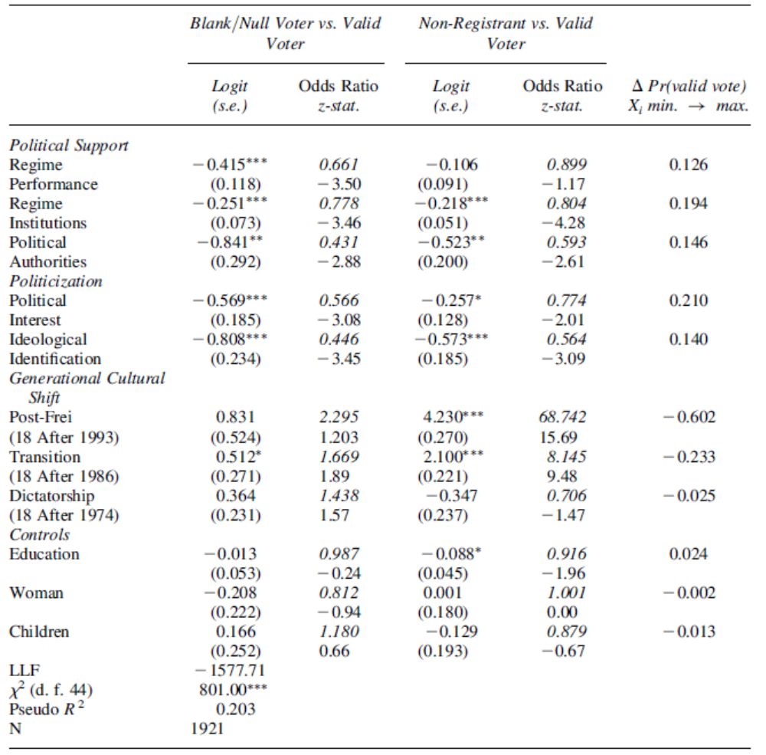
What do negative coefficients mean?
Which hypotheses hold?
Which variables are most substantively significant?

Slide 8
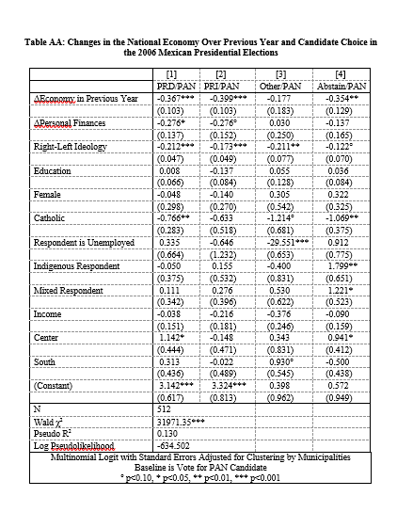
From Matthew Singer:
PAN is baseline

Slide 9
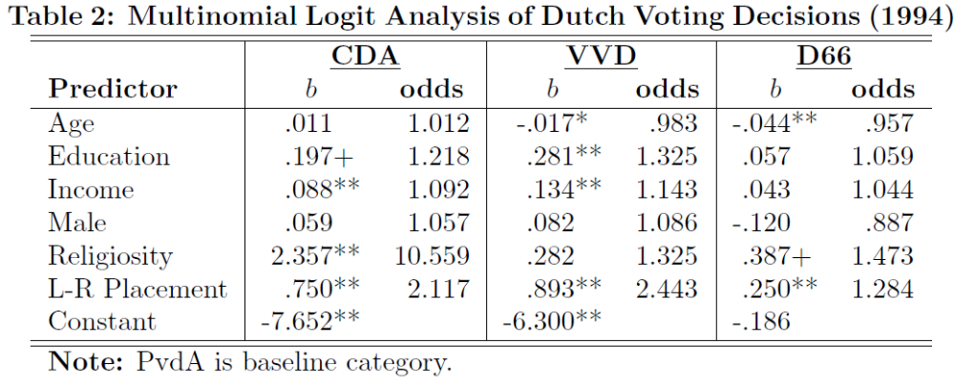
More Practice – from Marco Steenbergen

Slide 10
Key Point
Interpreting mlogit hypothesis tests requires looking at more than the p values
Need to consider variables that differentiate across other pairs of alternatives
Implication-there are a LOT of moving pieces to talk about as you write it up

Slide 11
Interpretation
Again, slopes don’t mean anything
Predicted probabilities/first differences
  Can do pretty much any of the techniques from last week

Slide 12
Independence of irrelevant alternatives (IIA)
IIA assumes the ratio of the choice probabilities for two alternatives, j and k, is independent from all other alternatives, l, in the choice set.
That is, regardless of whether those alternatives are in or out of the choice set, the probability of choosing j compared to the probability of choosing k remains the same
If you prefer chocolate to vanilla, that will hold true whether or not strawberry is an option
Frequently not true…

Slide 13
Testing for IIA
Basic Intuition-If drop one alternative, does the model stay the same?
Hausman-McFadden
  Compares coefficients
Small-Hsiao
  Compares model fit
  Subsets data

Slide 14
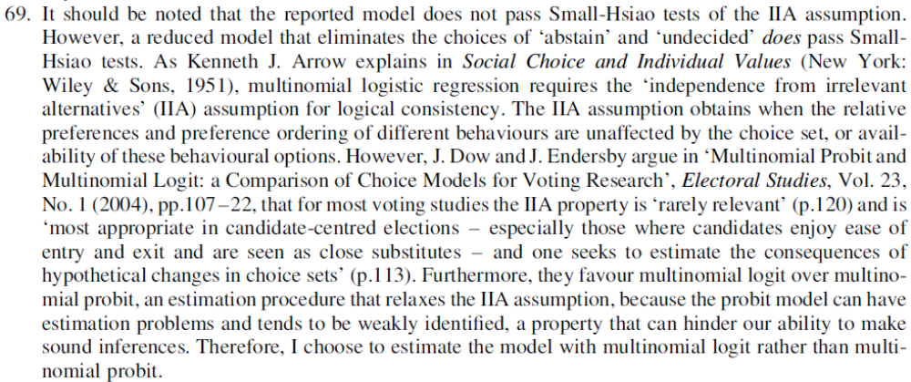
Did IIA hold for Carlin 2006?

Slide 15
Tactics for MNL
Think about your baseline for presentation
BUT table tells you only part of the story
  Consider all theoretically relevant the pairs
  Ask what IIA means for your study/model
Predicted probabilities and graphs are good, but there are limits to what can show/discuss well
Implication-have to use judgement, while not leaving stuff out

Slide 16
Multinomial Probit
Basic Intuition: Allow errors to correlate across options, relax IIA
In practice: VERY HARD to estimate (page 21)
  Set one parameter to 0
  Set one variance to 0
  Etc.
Running mprobit for my models took HOURS until I started setting variables to 0
Didn’t even change the results much ☹

Slide 17
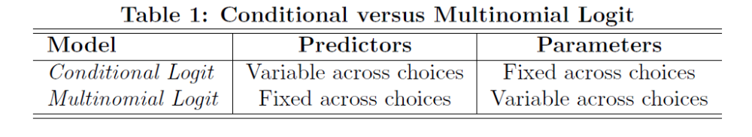
Conditional Logit

Slide 18
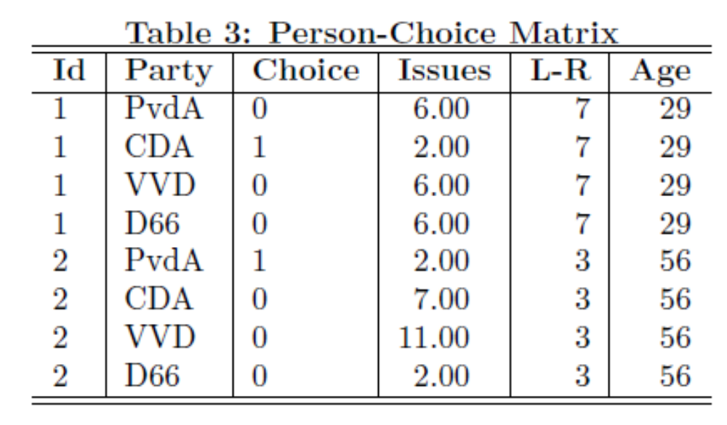
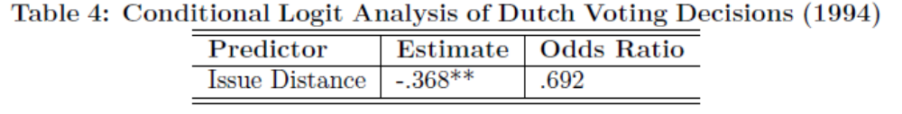
Conditional Logit

Slide 19


Slide 20
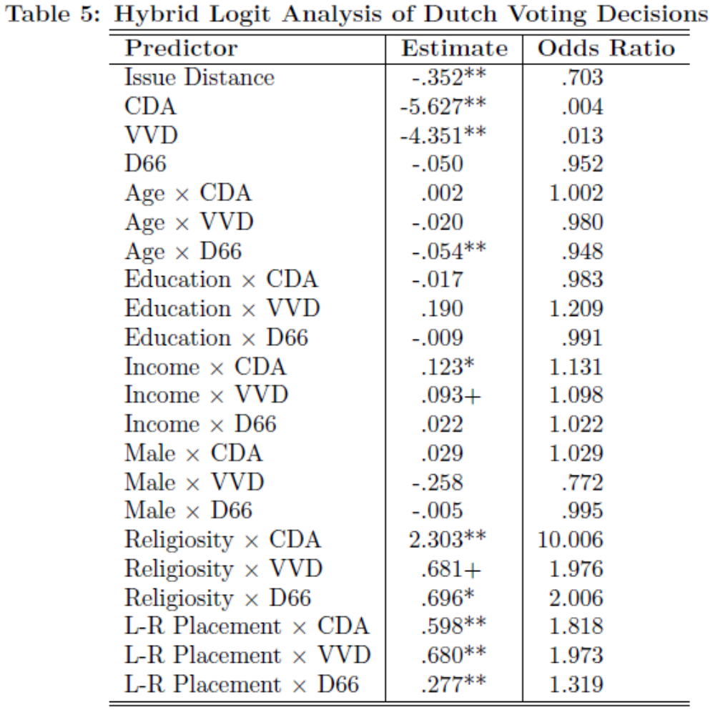
Conditional Logit

Slide 21
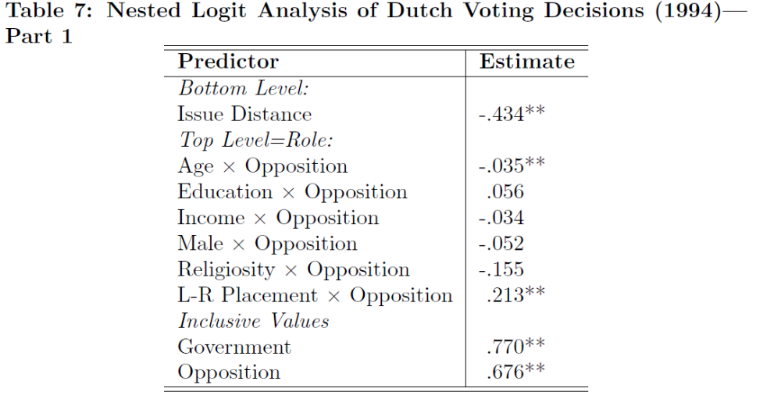
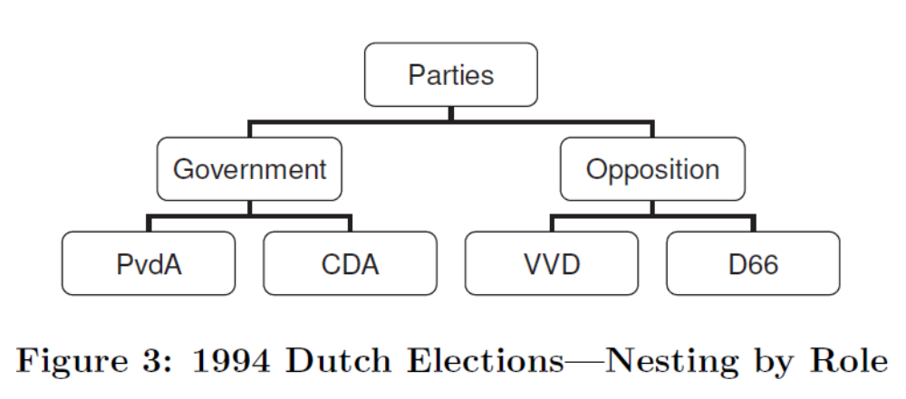
Nested Logit

